Slide 1
Investment Program Overview
Humboldt State University Advancement Foundation

Slide 2
Agenda
About RVK
Investment Portfolio Update
Green Funds Research
Spending Policy Impact

Slide 3
About RVK

Slide 4
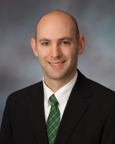
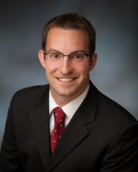
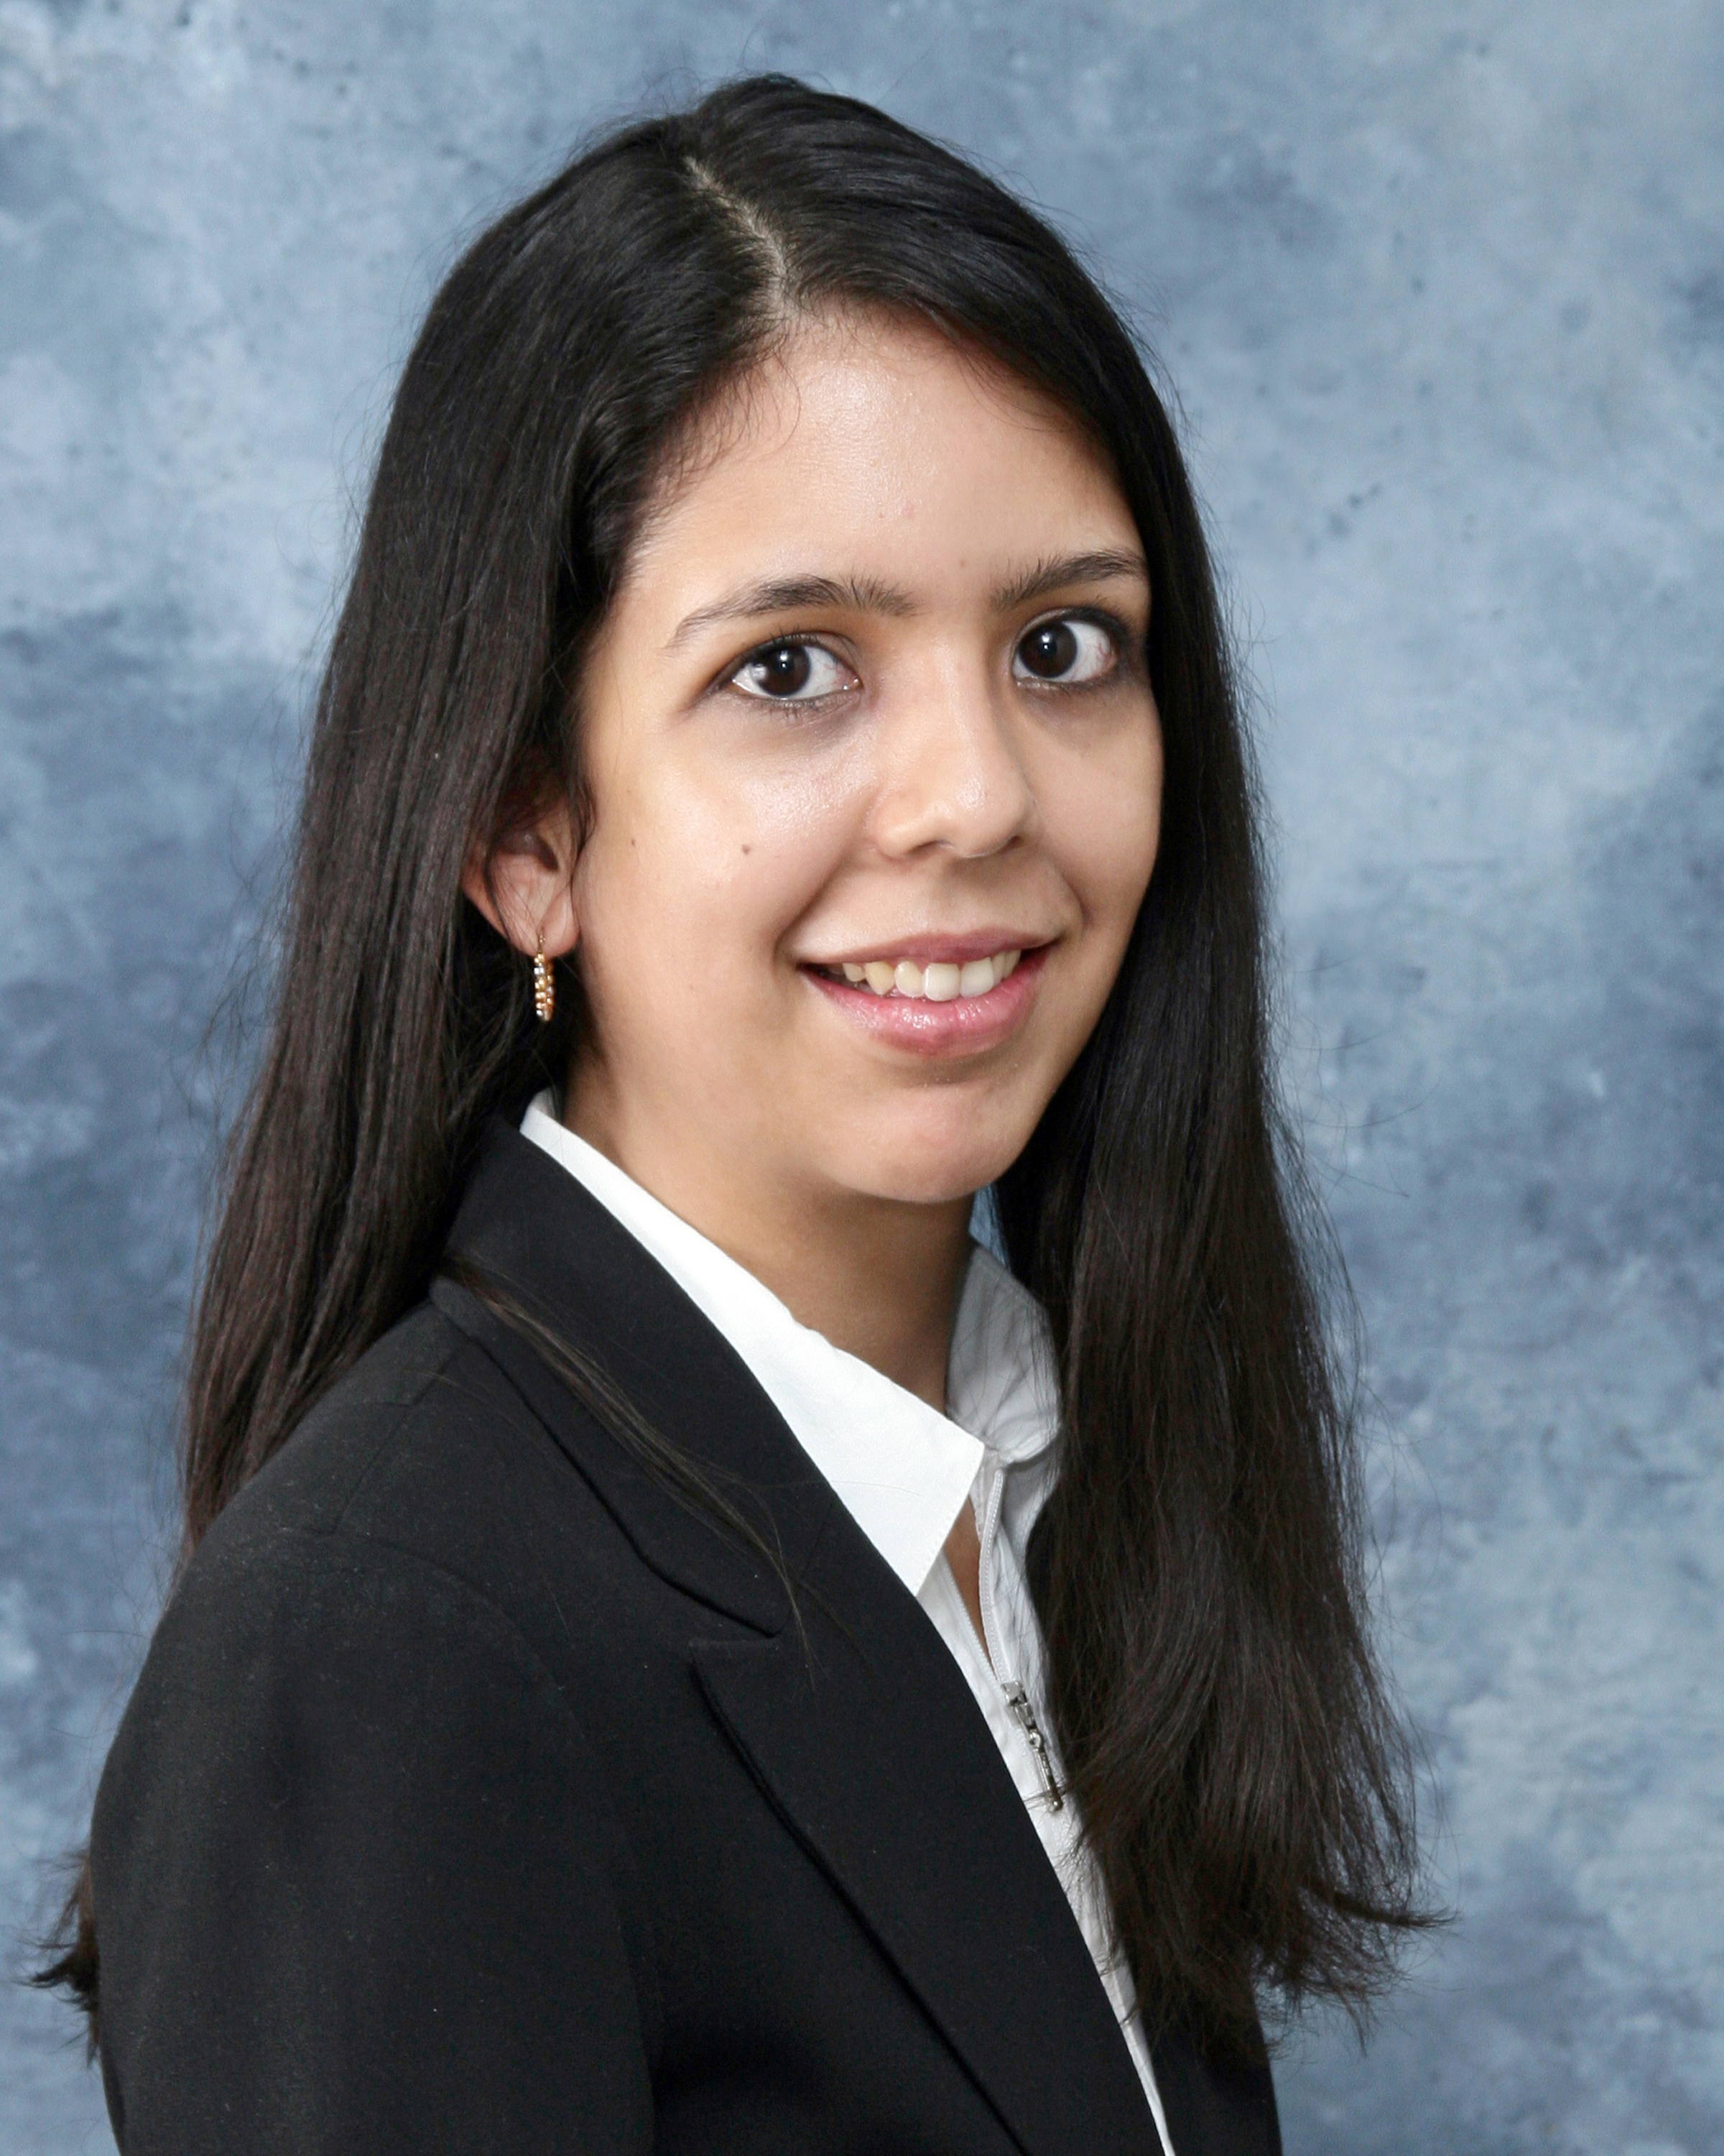
Consulting Team
Nick Woodward, CFA
Consultant
Nick joined RVK in 2007 as an Investment Analyst and serves as a Consultant in our Portland, Oregon office. His role includes consulting to a variety of the firm's pension plan, defined contribution plan and endowment/foundation clients. In addition to his consulting relationships, he is involved in the firm's capital market assumptions process and assists with general research efforts. Prior to joining RVK, Nick was an analyst with Bates Private Capital. Nick earned a Bachelor of Arts degree in Finance from the University of Portland, where he was an Entrepreneur Scholar, and holds the Chartered Financial Analyst designation. He is a member of the CFA Institute and the CFA Society of Portland.
Kyle Plitt, CFA
Consultant
Kyle is a Consultant based in RVK’s Portland office, having joined the firm in 2006. He advises a number of client relationships including endowments and foundations, retirement plans, and insurance portfolios. Kyle works directly with clients in developing portfolio asset allocation, investment manager due diligence, and general market research and education. He is a graduate of the University of Oregon with a Bachelor of Science degree in Business Administration – Finance. Kyle holds the Chartered Financial Analyst designation and is a member of the CFA Society of Portland.
Maritza Martinez
Associate Consultant
Maritza joined RVK in 2013 and serves as an Associate Consultant in the Chicago office. Prior to joining RVK, Maritza was a hedge fund researcher focused on commodity and inflation hedging manager research at Hewitt EnnisKnupp. She also assisted lead consultants with managing several institutional clients’ portfolios including public pension plans, endowments, and foundations. Maritza earned a Bachelor of Science degree in Economics and Statistics from the University of Chicago.

Slide 5


Firm Overview
RVK is independent, proactive and has no conflicts of interest; 100% of our revenue comes from cash payments by our clients, and our Code of Ethics has been in place since the inception of the firm
  No soft dollars
  No proprietary asset management products
  No services provided to investment managers
RVK is one of the top ten largest consultants as determined by Pensions & Investments
Portland, OR – Central Operations
New York, NY
Chicago, IL
100% Employee Owned
18 Employee Principals
Seven-Member Board of Directors
109 Employees
National Firm
Ownership Structure
400+ client plans nationally
Various account sizes and client types
Over $1 trillion in assets under advisement
Diverse Client Base
5

Slide 6
RVK Client Base
RVK serves a diverse client base by client type, plan type and asset size enabling us to share the best ideas regardless of source.
RVK has significant experience working with clients of all sizes.
6

Slide 7
Consulting Services Overview
RVK Offers Comprehensive Investment Consulting Services
General Consulting
Specialty Consulting
Trustee Education
Investment Policy Review and Development
Asset Allocation Analysis
Manager Search and Evaluation
Manager Monitoring and Due Diligence
Performance Reporting – Total Fund
Performance Reporting – Alternative Asset Classes
Manager Structure Studies
Real Estate Investment Program Development
Targeted Due Diligence on Direct Alternative Investments
Alternative Asset Due Diligence and Pacing
Stochastic Risk Analysis and Modeling
Liability Driven Investing Studies
Asset Liability Modeling
Legislative Issues Support
Strategic Planning and Organization Analysis
OCIO Search and Monitoring
Investment Operations Solutions Group
Defined Contribution Solutions Group
Securities Lending Program Development
Trade Execution Analysis
Organizational and Compensation Analysis
Trust/Custody Searches and Evaluation
Prime Brokerage Due Diligence and Selection
Cash Management Program Development
Transition Management
Plan Structure
Industry Trend Analysis
Third Party Administrator Evaluation
Investment Selection and Monitoring
Plan Operations and Platform Analysis
Fiduciary Policy Development and Implementation
Participant Education
7

Slide 8
RVK Culture
Key Elements of Our Culture
Collaborative, Team-Based Work Ethic
  We have fostered a culture that rewards individuals who work well together as a team with shared goals and shared values. We are meticulous in our recruiting efforts to ensure that new hires fit with this culture.
Dedication to Excellent Client Service
  Simply put, everything we do is centered around serving our clients beyond their highest expectation.
Innovation
  We challenge our associates each and every day by going above and beyond client expectations – this level of service permeates the organization from top to bottom.
Unwavering Commitment to Ethics
  Our service and our firm is designed to reinforce our dedication to the highest ethical standards. This has been, and will always be, a non-negotiable aspect of RVK.
Employee Ownership
  RVK is 100% employee owned and all RVK owners must be practicing consulting professionals.
8

Slide 9
Investment Manager Research
Depth of Resources Contribute to Client Service
Jim Voytko
Director of Research
Sean Ealy, CFA
Director of Investment Manager Research
Equity
Fixed Income
Alternative Strategies
Real Estate
Matt Sturdivan Manager Research Consultant
Joe Ledgerwood, CFA
Domestic – Long Only
Amy Hsiang,
CFA
Traditional Fixed Income, Alternative Credit
Steve Hahn,
CFA
Private Equity/Real Asset
Todd Shupp,
CFA
Multi-Strat/ FoHF/GTAA/DIS
Dan Krivinskas
Director of Real Estate Consulting
Britt Vriesman
Manager Research Analyst
Kasey Kuenzli, CFA
Senior Manager Research Analyst
Sonia Ruiz
Manager
Research Analyst
Reed Harmon, CFA
Senior Manager Research Analyst
Scott Krouse
Consultant
Alexander Leiken
Manager
Research Analyst
Kirby Francis
Manager Research Analyst
Joseph Jehl, CFA
Consultant
Robin Norgren
Data Analyst
Mark Bartmann
Associate
Consultant
Giuseppe Infusino
Investment Associate
Zach Straebel
Investment Analyst
9

Slide 10
Investment Manager Research
Relationship with Client & Consulting Team
Conduct manager oversight
Perform detailed due diligence in the course of manager searches on behalf of our clients
Identify suitable managers for client objectives
Conduct review of a client’s existing set of managers
Work directly with clients on searches as situations dictate
Conduct ad-hoc projects and requests (e.g. asset class reviews)
Client
Consultant Team
Investment Managers
Manager Research
10

Slide 11
Investment Portfolio Update

Slide 12
Investment Program Cornerstones
Diversification
Investment Tools
Periodic asset allocation studies
Appropriate mix by asset class (traditional and alternative)
Appropriate mix by investment manager (institutional quality)
Ongoing performance monitoring and due diligence
Periodic Investment Policy Statement review
Institutional custody of assets through US Bank
Risk/Return Expectations
Fees
Maximizing return for a given level of risk
Minimizing risk for a given level of return
Consistency with spending policy
Investment manager costs competitive with peers
Best (i.e. cheapest) available share class
Leverage of RVK relationships throughout the industry
12

Slide 13
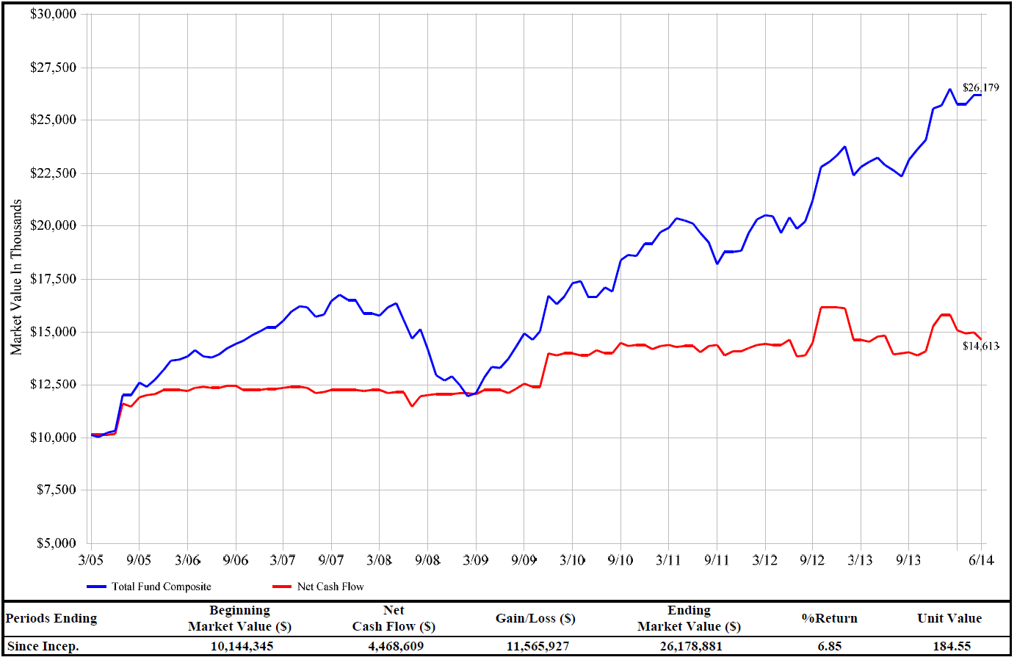
Investment Portfolio Update – Historical Growth
13

Slide 14
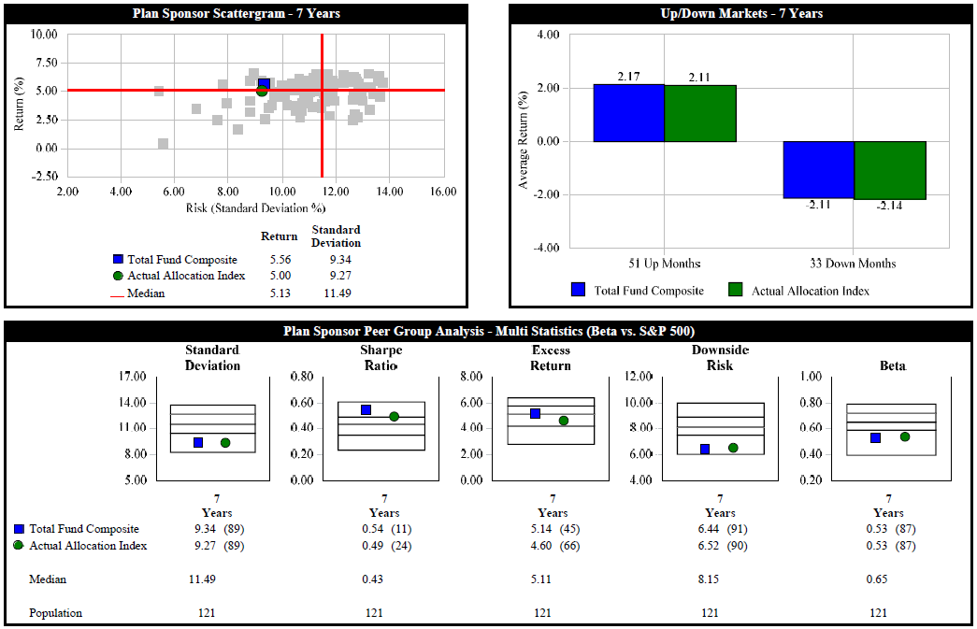
Investment Portfolio Update – Risk Metrics
14

Slide 15
Fiscal Year 2014 Review
15.5% return, net of fees
  Significantly exceeding Higher Education Price Index¹ (3.0%)
  In line with custom target allocation benchmark (15.7%)
In line with peers² (55th percentile)
    Excluding University Annex: 43rd percentile
  Third best fiscal year, in absolute terms, since 2005
5 years after the financial crisis, U.S. economy continues to improve
  Unemployment has fallen to 6.1%
  Inflation remains low (2.1%)
  The Federal Reserve has reduced their Quantitative Easing program
  Stocks posted double-digit returns during the fiscal year, outperforming non-U.S. equities
  Interest rates remain near historic lows
  The real estate market continues to recover
Fiscal Year | 2006 | 2007 | 2008 | 2009 | 2010 | 2011 | 2012 | 2013 | 2014
Total Fund | 10.2% | 17.2% | -2.4% | -15.3% | 10.9% | 19.5% | -0.1% | 11.1% | 15.5%
Target Allocation Benchmark | 9.6% | 17.2% | -3.6% | -15.1% | 10.3% | 19.7% | 2.6% | 9.8% | 15.7%
Peer Group Rank | 35 | 41 | 21 | 22 | 68 | 56 | 32 | 53 | 55
¹ The Higher Education Price Index is a measure of the inflation rate applicable to higher education in the U.S., specifically it measures the costs in a set basket of goods and services purchased by institutions of higher education.
² Endowments and Foundations with less than $500 Million in total assets included in Mellon Analytical Solutions Trust Universe along with the Investment Metrics Plan Sponsor Universe.

Slide 16
Recent & Future Objectives
Recent Objectives
January 2013: Global Tactical Asset Allocation strategy added
December 2013: Global Small Cap Equity added
April 2014: Social and Environmentally Responsible Offset and Mitigation Policy adopted
Summer 2014: Green Fund investment manager due diligence
Ongoing: Educational topic presentations to Finance Committee and staff; investment manager due diligence; investment policy review
Future Objectives
Green Fund investment
Asset allocation review

Slide 17
Green Funds Research

Slide 18
Investment Program Cornerstones: Green Funds
Diversification
Investment Tools
Eliminating sectors and industries potentially reduces diversification
Limited product availability and historical experience may require extensive due diligence
Challenge in performance benchmarking
Risk/Return Expectations
Fees
Exclusion of sectors and industries can potentially reduce return and increase risk
Increase in Fees
  Green Fund ~1.00%
  Current US Eq. Portfolio: ~0.38%
18

Slide 19
Green Funds Research
RVK has spent considerable time conducting due diligence on “Green Fund” strategies
Due Diligence Calls
  DFA – 6/23
  Calvert – 6/26
  Vanguard – 6/27
  Trillium – 6/27
  Walden – 6/30
  Parnassus – 6/30
  Parametric – 7/2
On-Site Visits
  Parnassus – 8/28
  Walden – TBD
  Trillium – TBD
Establish Criteria
Portfolio Design Goals
Quantitative Analysis
Performance Consistency
Risk/Return Profile
Peer Rankings
Qualitative Analysis
Investment Philosophy
Team Stability
Risk Controls
Resource Depth
Interviews
Adherence to Style
Source of Returns
Incentive Structures
Manager Selection
Best Fit w/
Existing Options

Slide 20
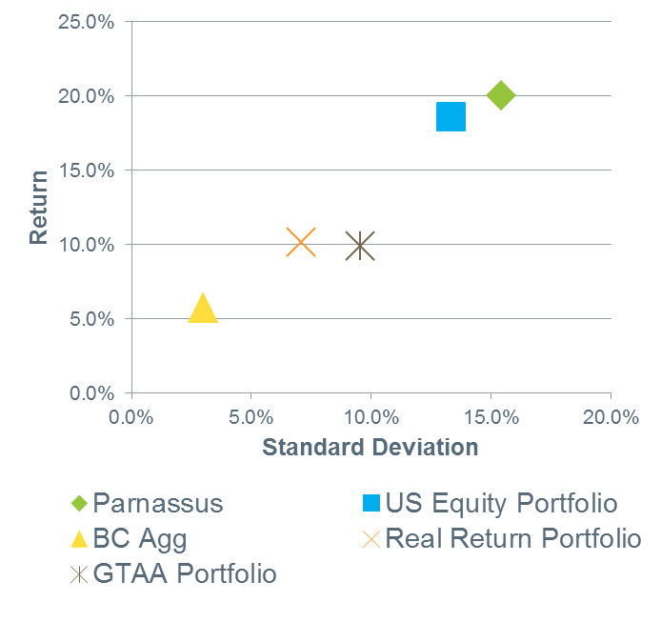
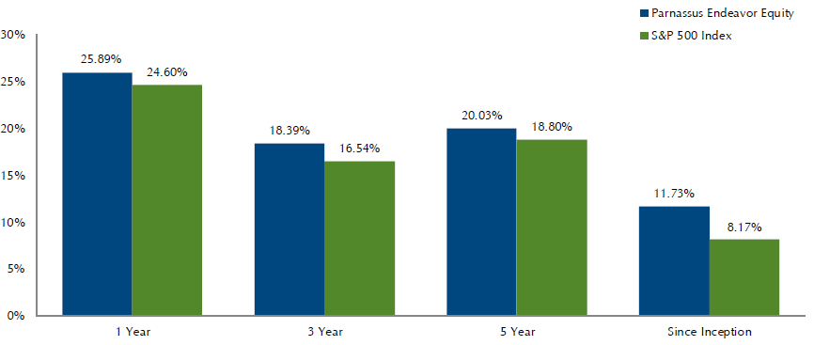
Green Fund Example
Parnassus Endeavor (PARWX)
Management Style | ESG Focus
Active Large Cap Domestic Equity with a Growth Tilt | Fossil Fuel Free as of May 2014. Portfolio excludes extraction, exploration, production, manufacturing, and refining companies as well as integrated oil companies and utilities with majority of assets in natural gas. This strategy also overweight’s companies that are good work places, with the philosophy that it will be easy to recruit and retain better employees and perform at higher level than competitors in terms of innovation, productivity and customer loyalty, and profitability.
5-Year Returns

Slide 21
Concerning Sectors: Holdings Screen
Green Funds significantly reduce and/or fully exclude exposure to concerning sectors and industries
(1) Screened stocks are publicly-traded securities within the appropriate GICS Industry or Sector classification.
(2) U.S. Equity and Total Global Equity Markets are represented by the sum of all GICS sectors. Sector and Industry market values are represented by respective GICS Sectors and Industries from Bloomberg.
* The "Filthy 15" compromise of the following corporations that are deemed to be the largest and dirtiest energy producers; Arch Coal Inc., Ameren Corp, American Electric Power Company Inc., Alpha Natural Resources Inc., CONSOL Energy Inc., Dominion Resources Inc., Duke Energy Corp, Consolidated Edison Inc., Edison International, FirstEnergy Corp, NRG Energy Inc., PPL Corp, and the Southern Company.
21

Slide 22
Spending Policy Impact

Slide 23
Green Fund Investment & Spending Policy Impact
It is difficult to determine the performance impact of investing in green fund strategies.
  A conservative estimate suggests that ex Fossil Fuel funds may underperform slightly over the long-term (~1.0%) versus the current portfolio structure, but with the possibility to outperform at times.
The total performance impact on the Advancement Foundation’s spending policy will depend on the total allocation to green funds.
  The below table illustrates our estimated impact:
Portfolio Structure | Green Fund Allocation | Estimated Performance Impact | Spending Policy
Current Policy | 0% | N/A | 4.0%
Intro to Green Funds (50% of large cap equity) | 11% | -0.11% | 3.9%
Green Large Cap Equity | 22% | -0.22% | 3.8%
Green Traditional Assets | 73% | -0.73% | 3.3%
Full Implementation | 100% | -1.00% | 3.0%
23

